Slide 1
Neural Networks and Deep Learning
How Neuronic (perceptronic) computations are designed and how and why they work

Slide 2
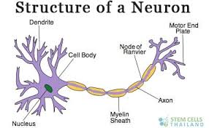
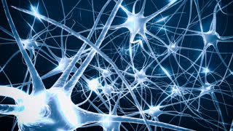
Definition and Structure of a neuron and a perceptron
The perceptron is a simplified model of a biological neuron. While the complexity of biological neuron models is often required to fully understand neural behavior, research suggests a perceptron-like linear model with activation can re-produce some behavior seen in real neurons.
The above are graphical pictures of structure of a single neuron and a network of neurons.
We abstract the network of neurons as a collection of layered network of perceptrons.

Slide 3
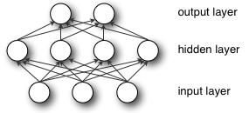
What are (artificial) neural networks ?
An artificial neural network (ANN) is an algorithmic representation of the biological network of neurons.
Each perceptron takes in multiple inputs and combines them linearly, with certain weights and bias, and normalizes the result with an activation function.
In the above graph, every circle is a perceptron. The collection of all the layers of circles is called a Multi-Layered Perceptron network (MLP)
The bottom layer consists of three input perceptrons, and all others are computed perceptrons. Totally there are 9 neurons in this Artificial Neural Network.

Slide 4
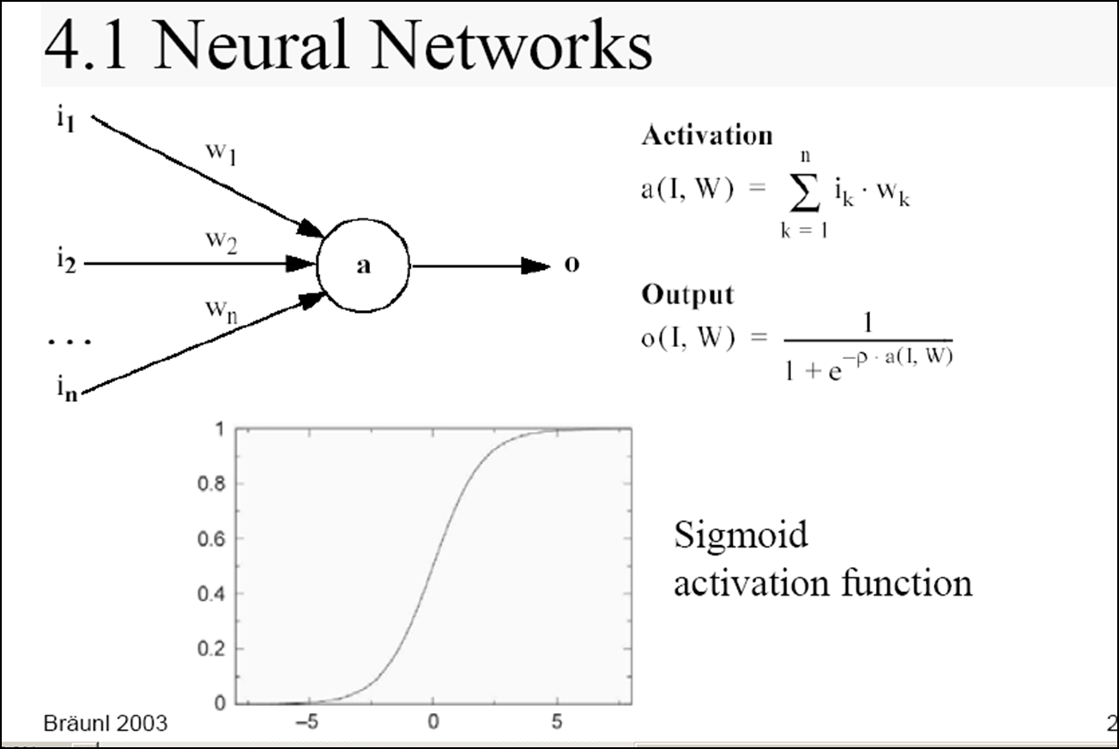
Building a Forward Pass and Back Propagate Errors – Do the Iteration
This is sum product in MS Excel; we say weighted input
This evaluates the signal strength
Neural Networks Notes

Slide 5
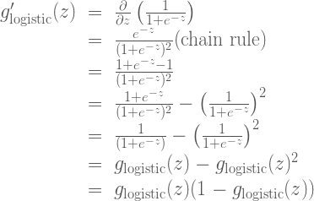
Mathematical structure of gradient that we will use in the back propagation for Sigmoid Activation

Slide 6
Making a Perceptron Learn!
Supervised inputs and outputs drives the learning process
Weighted calculations from one layer to another layer are written and activated for signal strength
Learning step adjusts weights of signal strengths from one cell to another layer cell proportionate to the errors between the calculated and the supervised outcome value,
How to change the weight in relation to the differences in the supervised outcome value vs. calculated value at each iteration ?
Δweight_{i,j} = α * [supervisor_{i} – calculated output_{i}] * input_{j}
where:
α is the learning rate;
(supervisor_{i} – calculated output) is the propagating error;
and input_{j} is the input activated values
w_{i,j =} w_{i,j} + Δw_{i,j} is the updating formula for the weight w, from perceptron node i in jth iteration
Learning adjustment change rule – delta rule

Slide 7
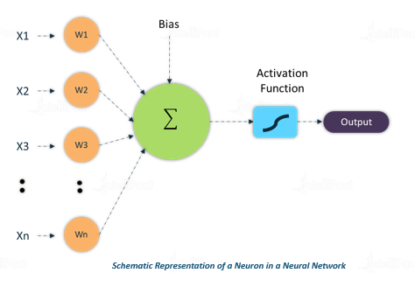
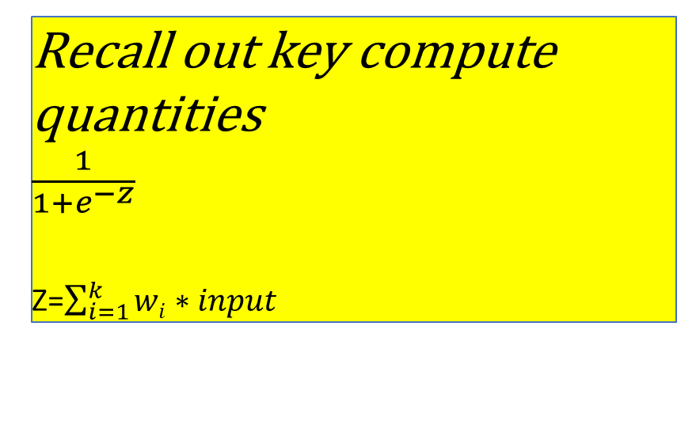
Circles are neuron – decision point or information receiver or transfer point with added experiential weights.
Connectors are synapses, utilizes the information weights and transferer of information; takes the information to its network of neurons
Thus, an artificial neural network is an interconnected information processing collection of neurons connected by synapses, where input is received, information is processed, and output created
Recall out key compute quantities
$\frac{1}{1+e^{−z}}$
Z=$\sum_{i=1}^{k}{wi∗input}$
In a supervised algorithm, we know the output. Say, it is 0.5 here.
The inputs are

Slide 8
A simple network as to how humans think to make a decision
Economic development vs. equitable society
Parents neuron
Spouse neuron
Vote for Trump /Biden
One hidden layer

Slide 9
Mathematical structure of gradient that we will use in the back propagation for Sigmoid Activation
Derivative of logistic function – the direction where the descent has to happen to reach minimum of the error

Slide 10
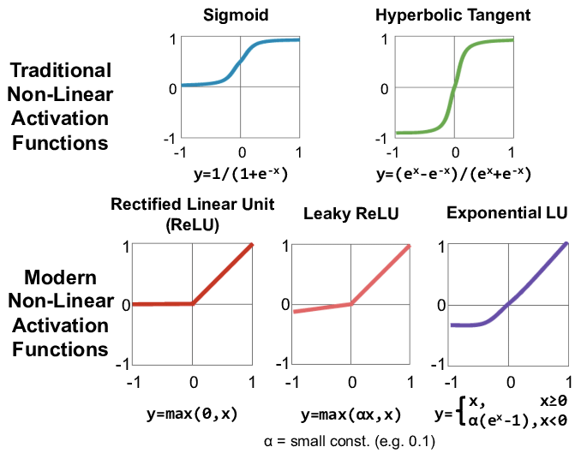
Three Most Important Activation Functions

Slide 11
Notes on Back Propagation of errors and computational ideas – Key is Page 20 where we show how the ‘feed forward and back propagation are integrated – Adobe Document

Slide 12
Two Input neurons, Two Hidden layers each with 3 neurons, Two Outputs neurons – How computers can be used to expand networks and
Inputs
Outputs
First Hidden layer
Second Hidden layer
https://people.orie.cornell.edu/davidr/or474/nn_sas.pdf

Slide 13
What is deep learning, how is it related to ANN, and Other Algorithms
http://machinelearningmastery.com/what-is-deep-learning/

Slide 14
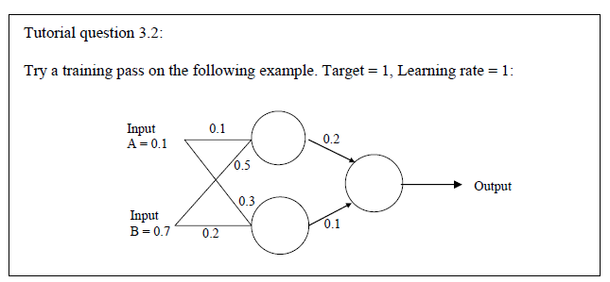

Slide 15
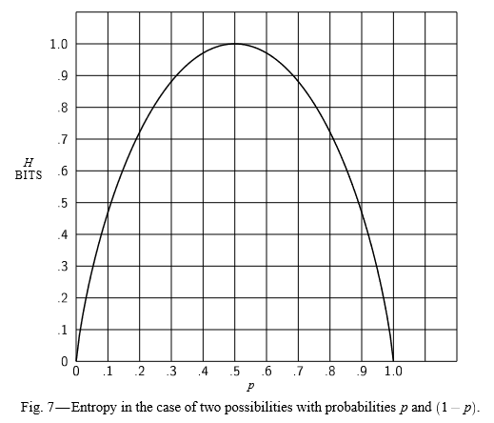
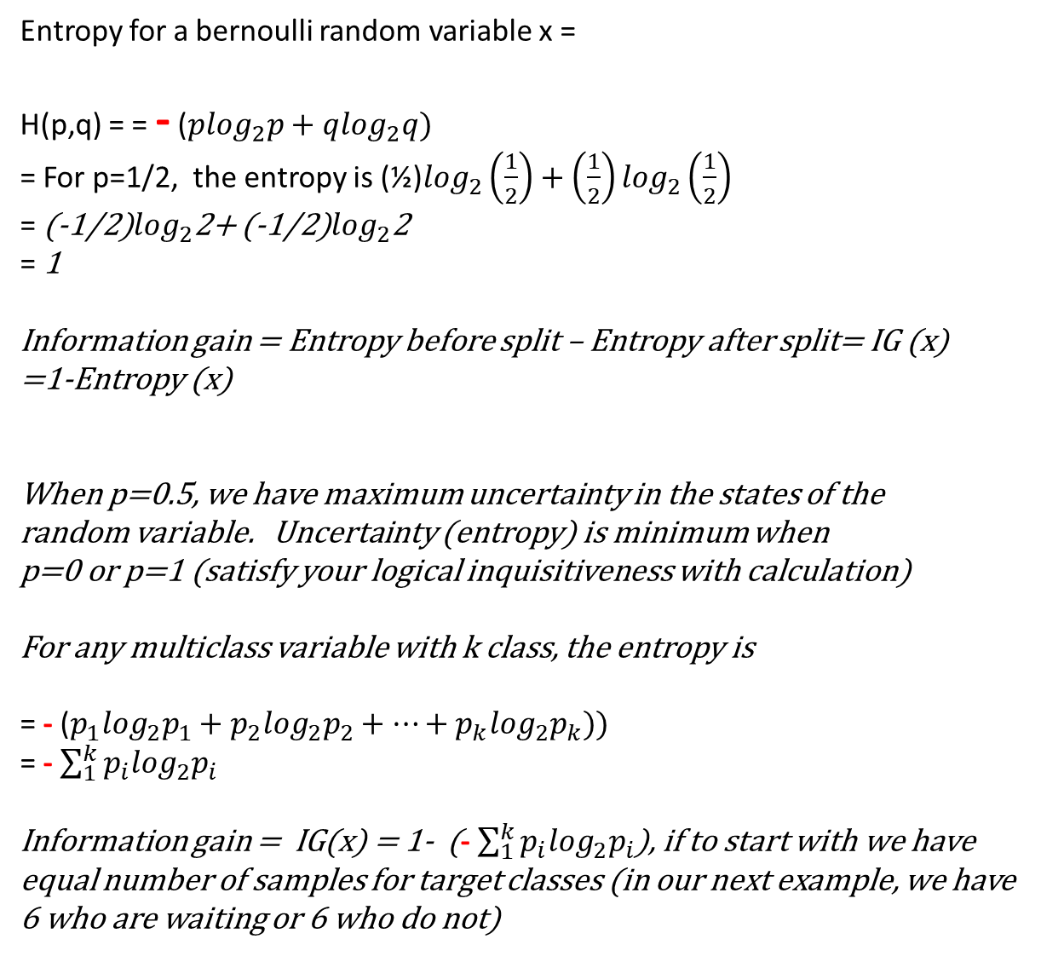
Entropy for a bernoulli random variable x =
H(p,q) = = - ($p\log_{2}p+q\log_{2}q)$
= For p=1/2, the entropy is (½)$\log_{2}\left(\frac{1}{2}\right)+\left(\frac{1}{2}\right)\log_{2}\left(\frac{1}{2}\right)$
= (-1/2)$\log_{2}$2+ (-1/2)$\log_{2}$2
= 1
Information gain = Entropy before split – Entropy after split= IG (x)
=1-Entropy (x)
When p=0.5, we have maximum uncertainty in the states of the
random variable. Uncertainty (entropy) is minimum when
p=0 or p=1 (satisfy your logical inquisitiveness with calculation)
For any multiclass variable with k class, the entropy is
= - ($p_{1}\log_{2}p_{1}+p_{2}\log_{2}p_{2}+…+p_{k}\log_{2}p_{k}))$
= - $\sum_{1}^{k}{p_{i}\log_{2}p_{i}}$
Information gain = IG(x) = 1- (- $\sum_{1}^{k}{p_{i}\log_{2}p_{i}}$), if to start with we have equal number of samples for target classes (in our next example, we have 6 who are waiting or 6 who do not)
Entropy as performance measure – Used in loss functions in predictions
http://cm.bell-labs.com/cm/ms/what/shannonday/shannon1948.pdf
This is one of the best engineering/statistical paper of 20th century

Slide 16
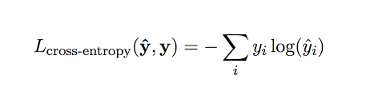
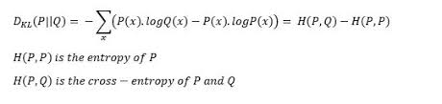
Cross-entropy loss function

Slide 17
Batches, Epochs, Learning Rate, Drop rates…
10000 samples, batch size=500, number of batches = 10000/500 =20, Epoch = 1 full cycle of going over the 20 (16) batches, usually we do a number of epochs.
For every batch we have a cross-entropy loss; average it for 20 batches and
We will do 10 times, if our epoch=10
Learning rate is the change step in the loss function reduction for iterative approximation step in the gradient decent.

Slide 18
Image analysis – Retail - Attached is the ipynb (jupyter notebook)
- This file is separately posted in the github below Module 3
Image analysis – Handwritten numbers
- This file is separately posted in the github below Module 3

